Slide 1
Advancing InfoSec Towards an Open, Shareable, Contributor-Friendly model of speeding InfoSec learning
John Lambert, @JohnLaTwC
Microsoft Threat Intelligence Center

Slide 2
If you want to go fast, go alone If you want to go far, go together African Proverb

Slide 3
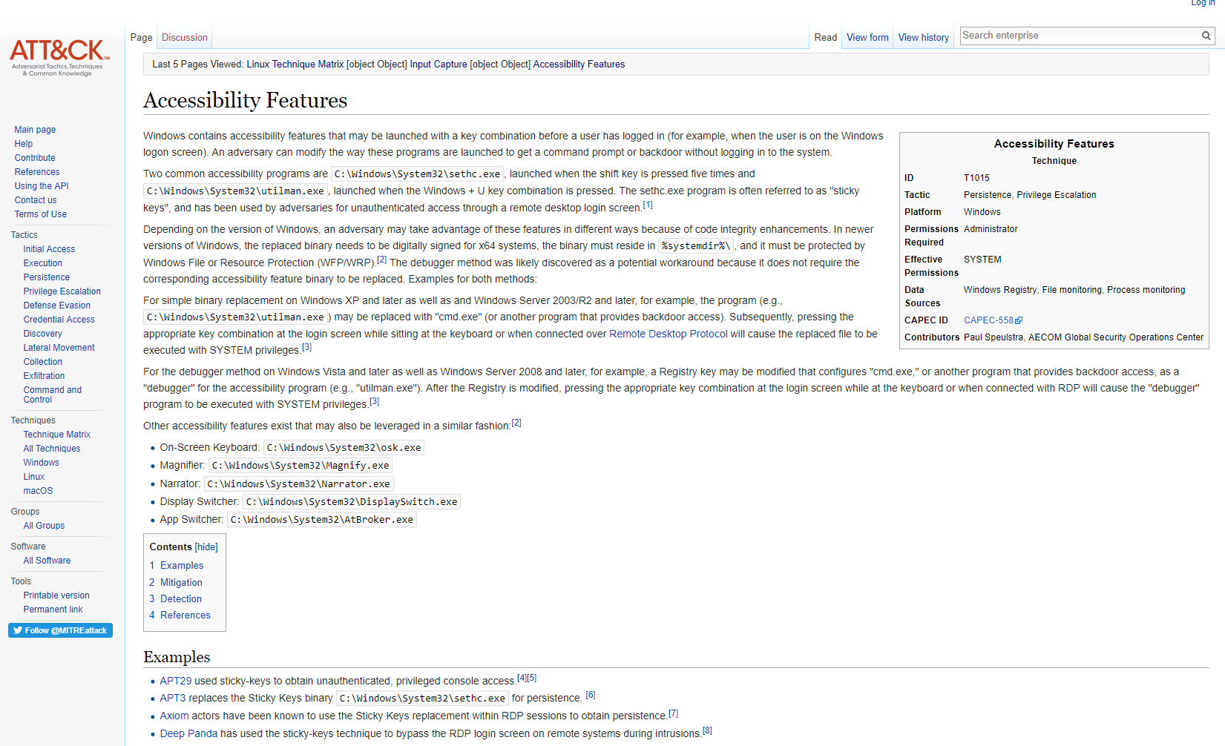

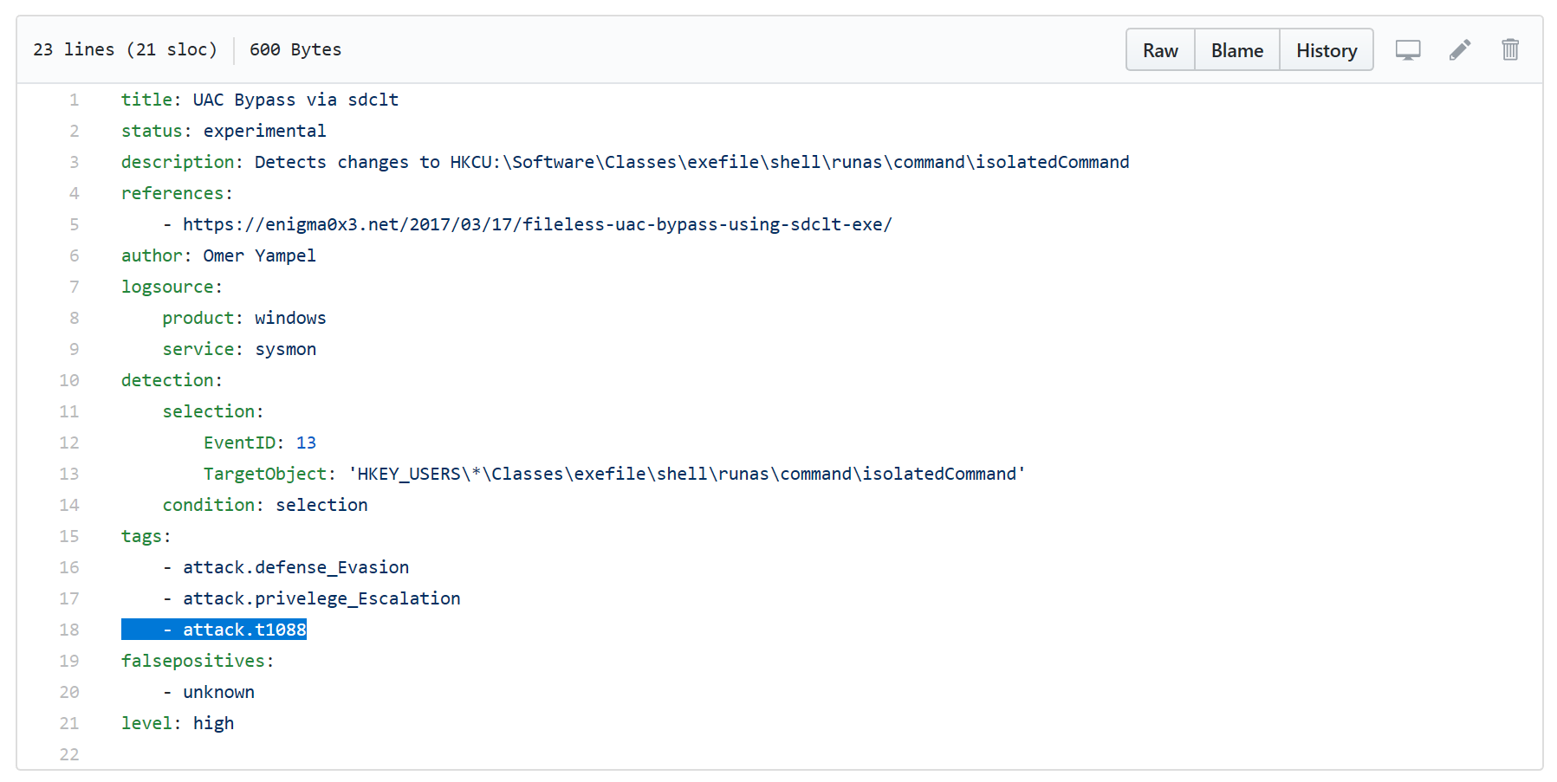

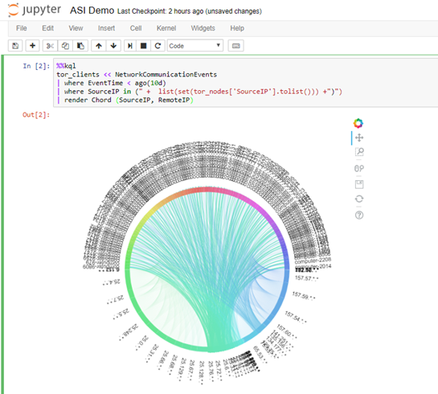

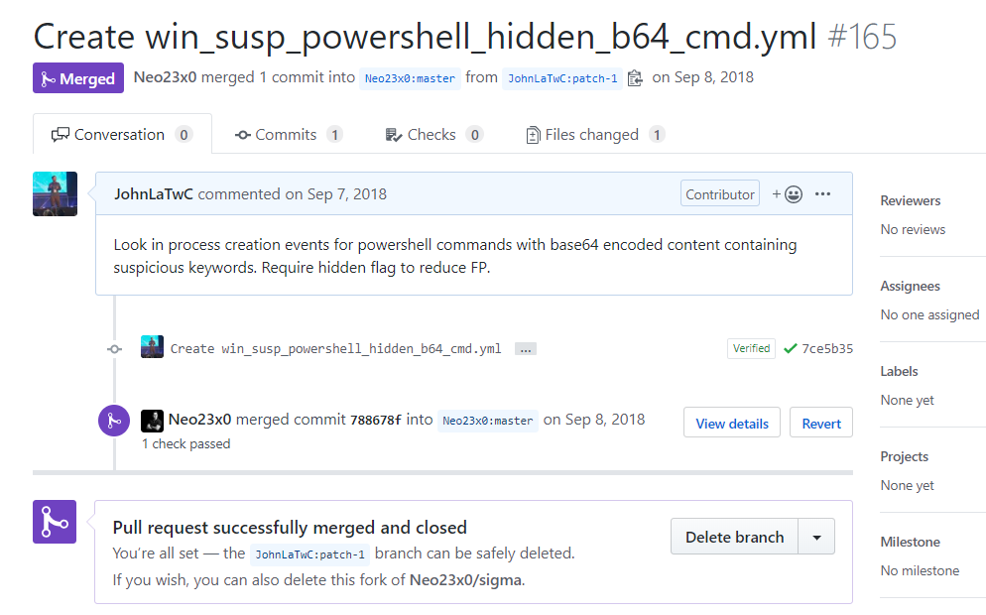



Organized Knowledge
How do understand new techniques and threats as a cohesive whole? How do you avoid each defender having to do this on their own?
Executable
Know-how
How do you translate insight into defensive action? How could you describe a new techniques and threats in a way that it is usable agnostic of environment?
Repeatable
Analysis
How do you make analysis repeatable, explainable and shareable? Can you share analytical expertise?
Promoting Community
All these elements exist because of a community. Technology is needed but learning cannot happen without teaching and teaching is built on contribution.

Slide 4
Organized Knowledge

Slide 5
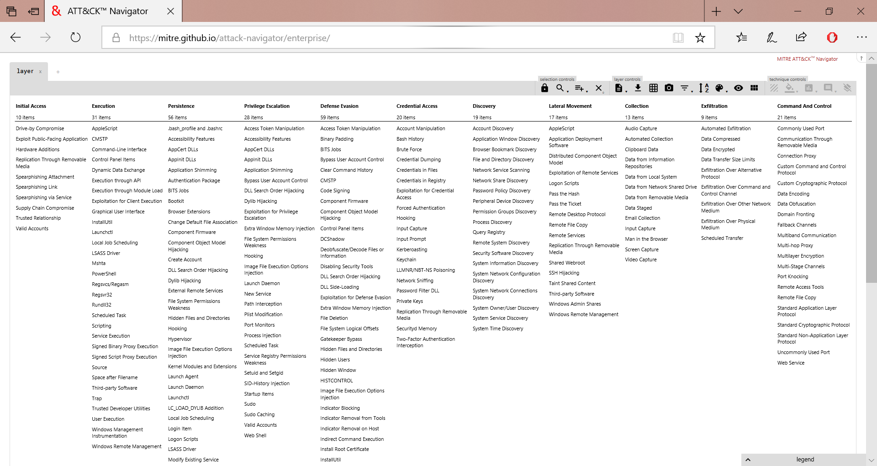
Knowledge

Slide 6
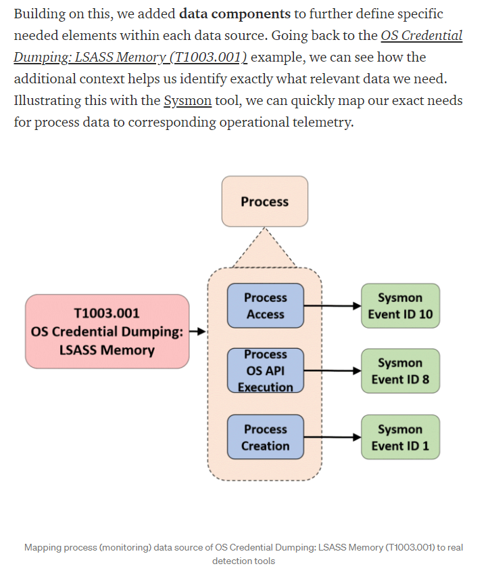
New and Enhanced Domains for ATT&CK
New domains:
ICS/OT
Containers
Cloud
Redefined Data Sources
Define data sources needed for detection
What logs have the data?
Specify data components
What values are necessary to collect?
Examples: process, file, command, and network traffic
What’s New in ATT&CK v9?. Data Sources, Containers, Cloud, and more | MITRE ATT&CK® (medium.com)

Slide 7
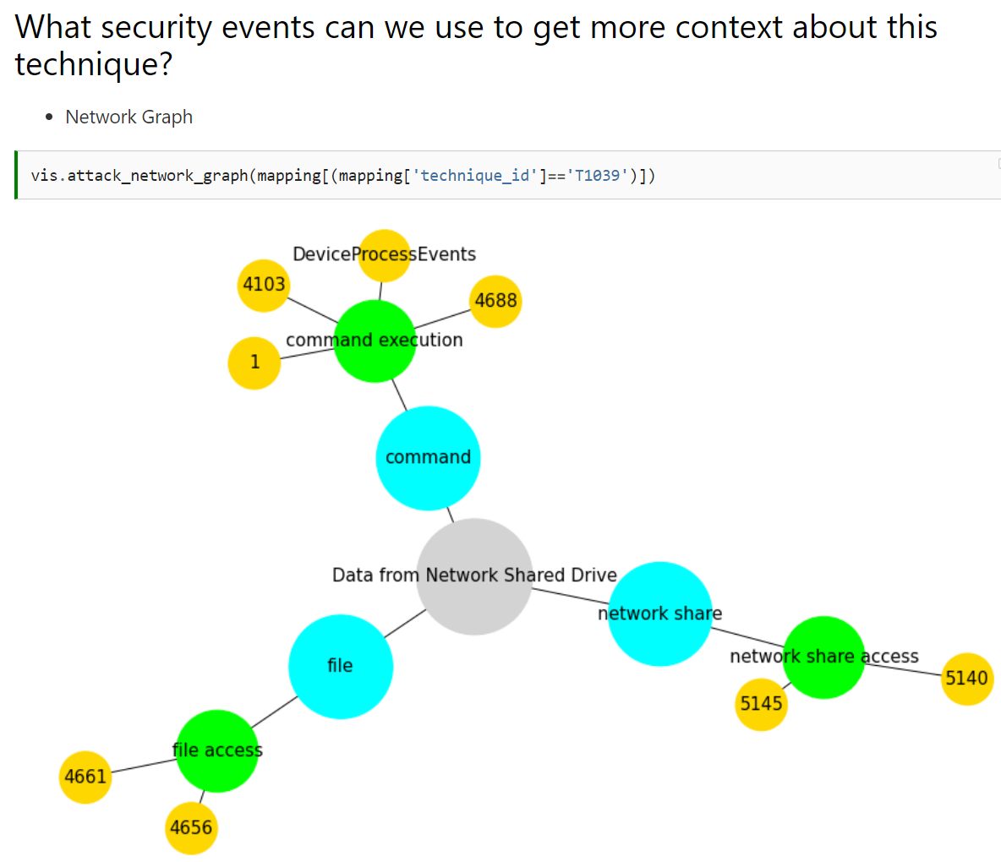
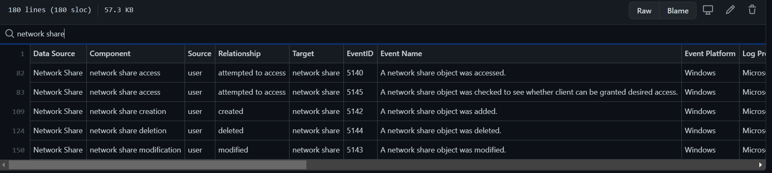
Mapping Data Sources to Security Events
OSSEM Detection Model
A community driven effort by the Open Threat Research (OTR) community
Map ATT&CK data sources -> data components -> Security Events
A Jupyter Notebook to show mappings in a network knowledge graph
ATT&CK Techniques to Security Events — The OSSEM Project

Slide 8
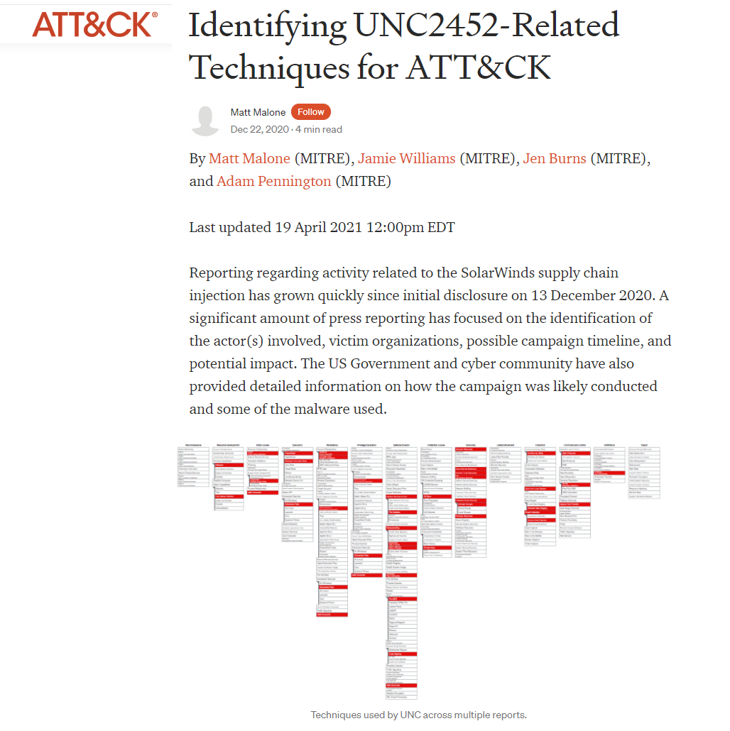
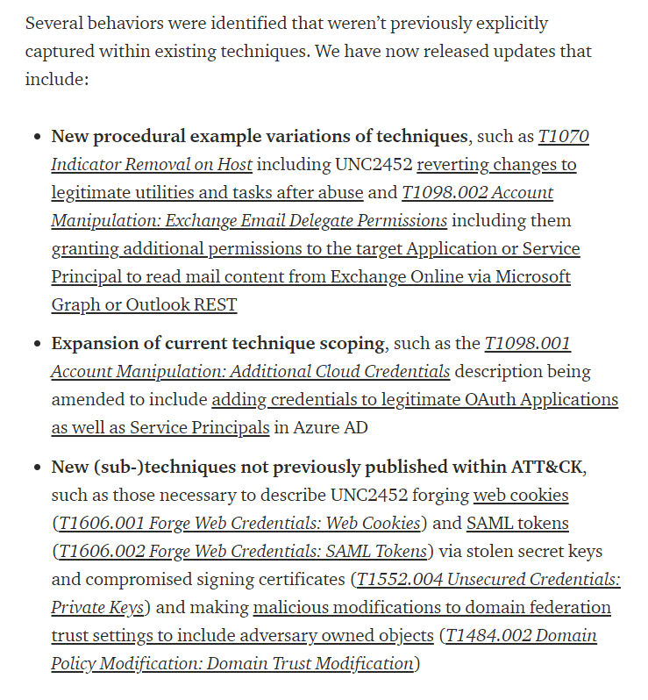
ATT&CK applied to SolarWinds Actor
UNC 2452 (aka NOBELIUM)
Highlights which TTPs were observed
New techniques and variations added
https://medium.com/mitre-attack/identifying-unc2452-related-techniques-9f7b6c7f3714

Slide 9
Executable Know-how

Slide 10
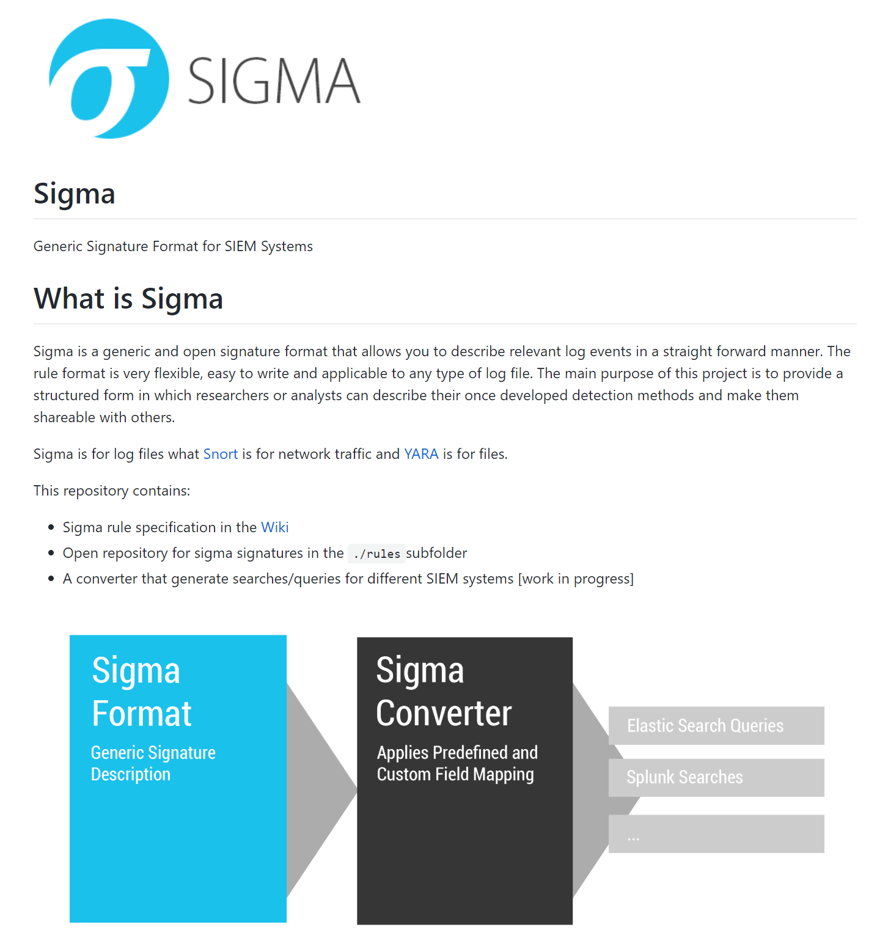
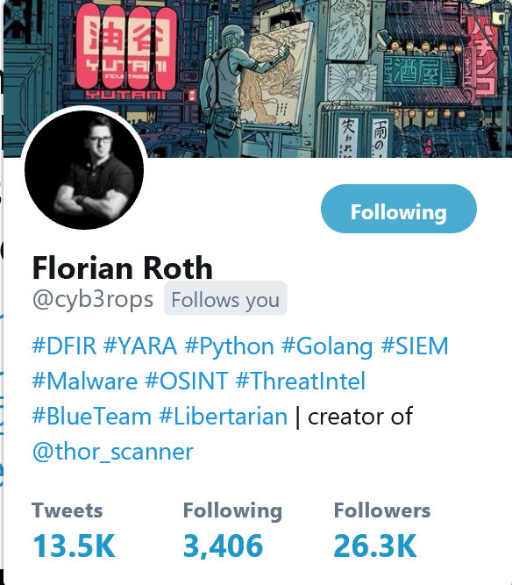

Slide 11
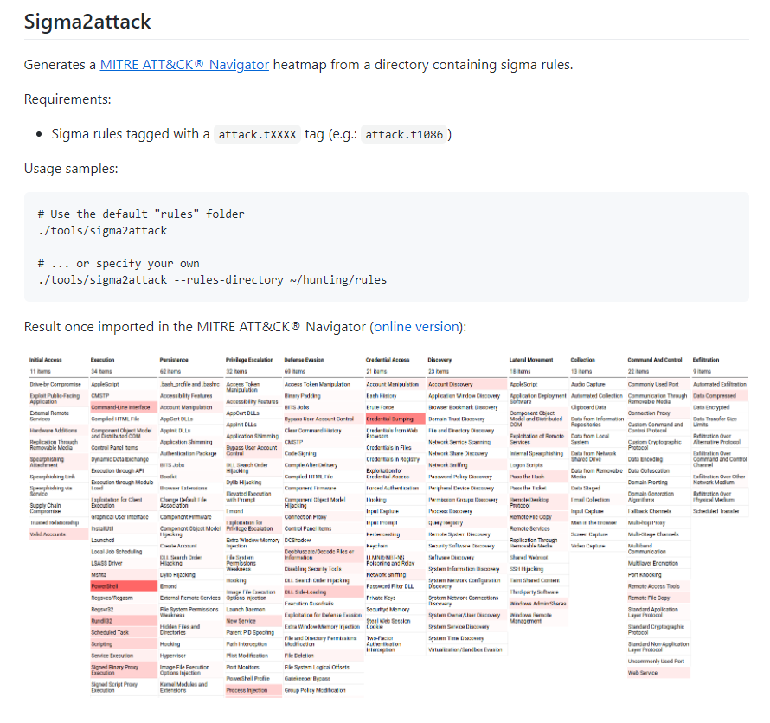
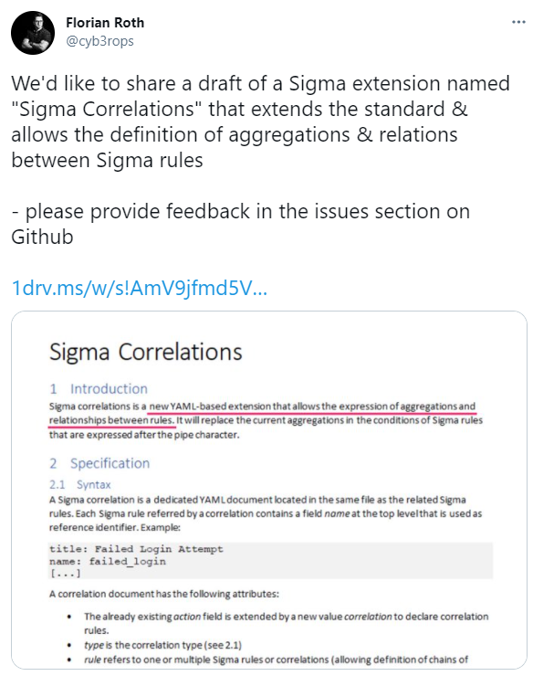
Sigma Developments
Sigma2Attack
Sigma correlations
https://twitter.com/cyb3rops/status/1338180505511063554

Slide 12
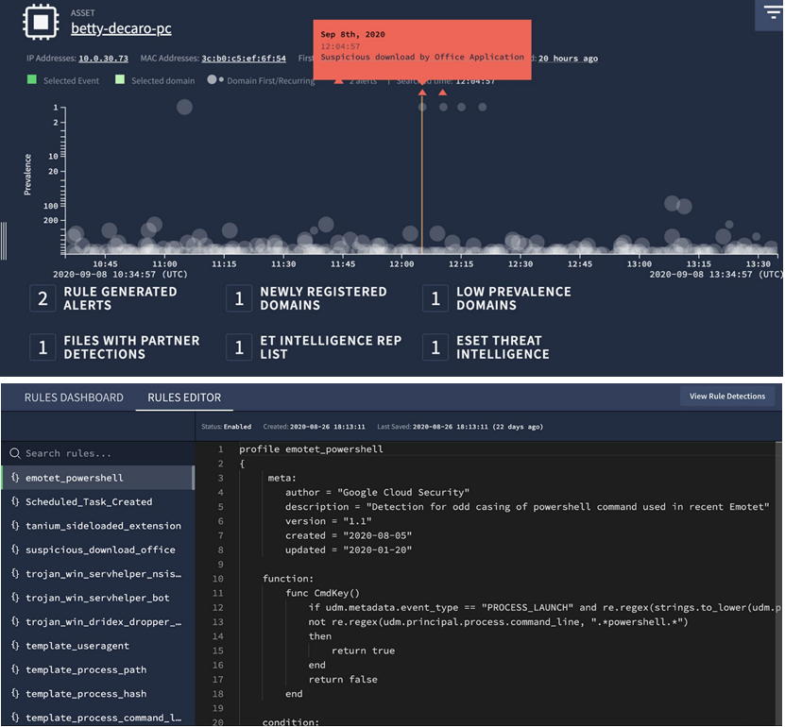
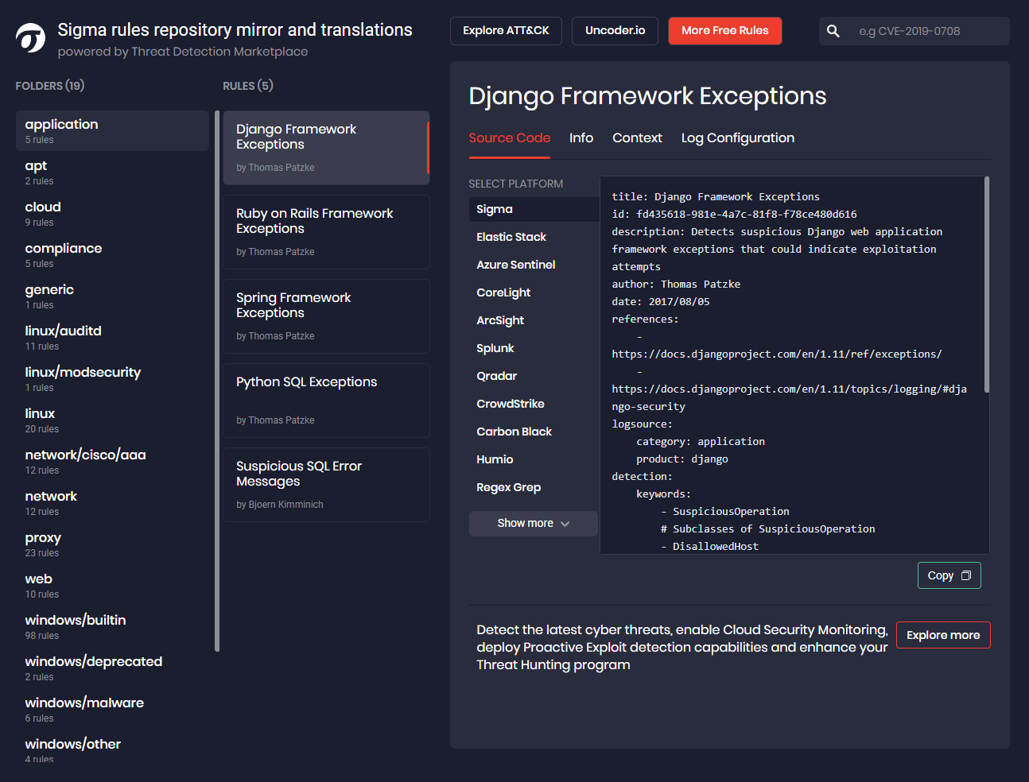
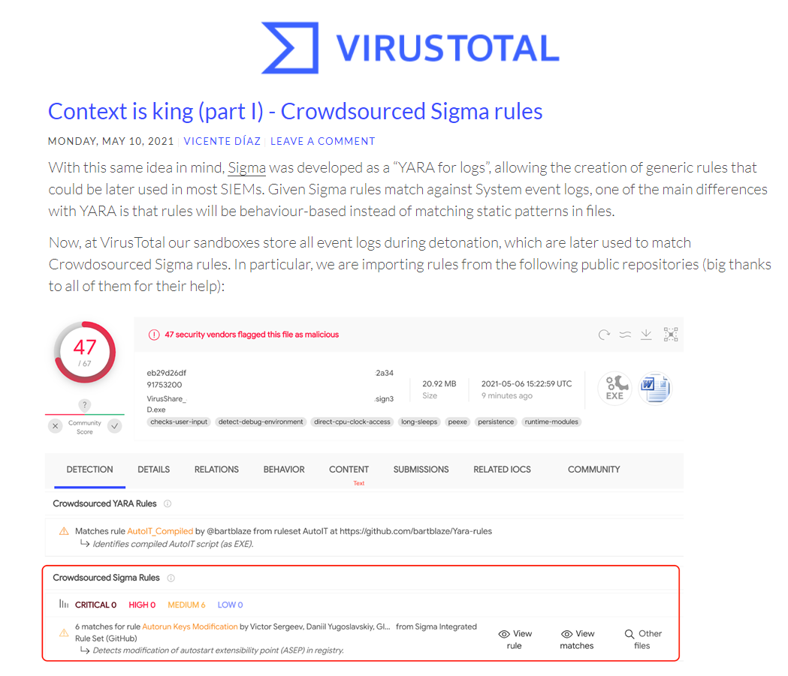
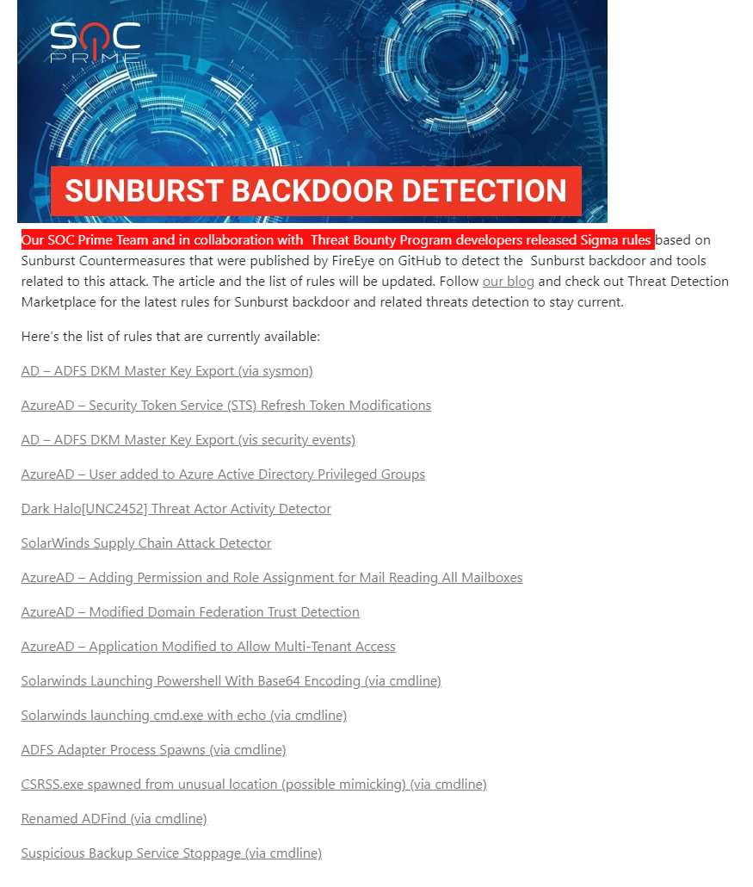
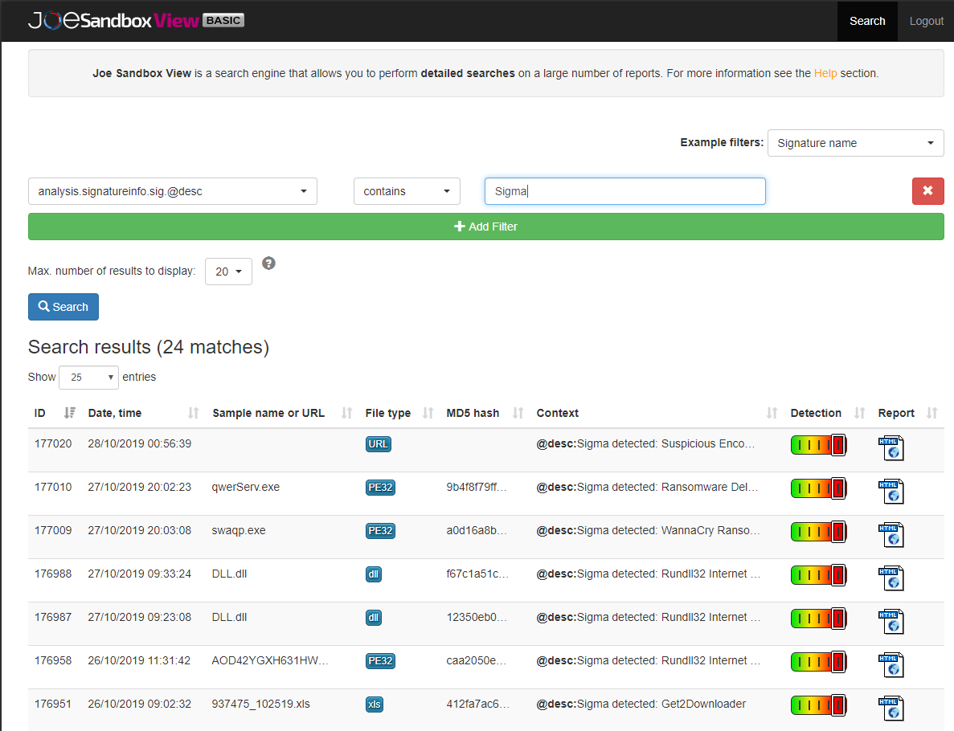
Sigma Rule adoption in SecOps prodcuts
JoeSandbox
SOC Prime
VirusTotal
Chronicle Detect
Notes:
SOC Prime on Twitter: "Explore #Sigma rules repository mirror by SOC Prime - https://t.co/xUGvuSgNYS Just in few clicks you can find and translate available rules to detections compatible with your security platform. No registration required! #Cybersecurity #SIEM #ThreatHunting #BlueTeam https://t.co/N4SDFci37P" / Twitter

Slide 13
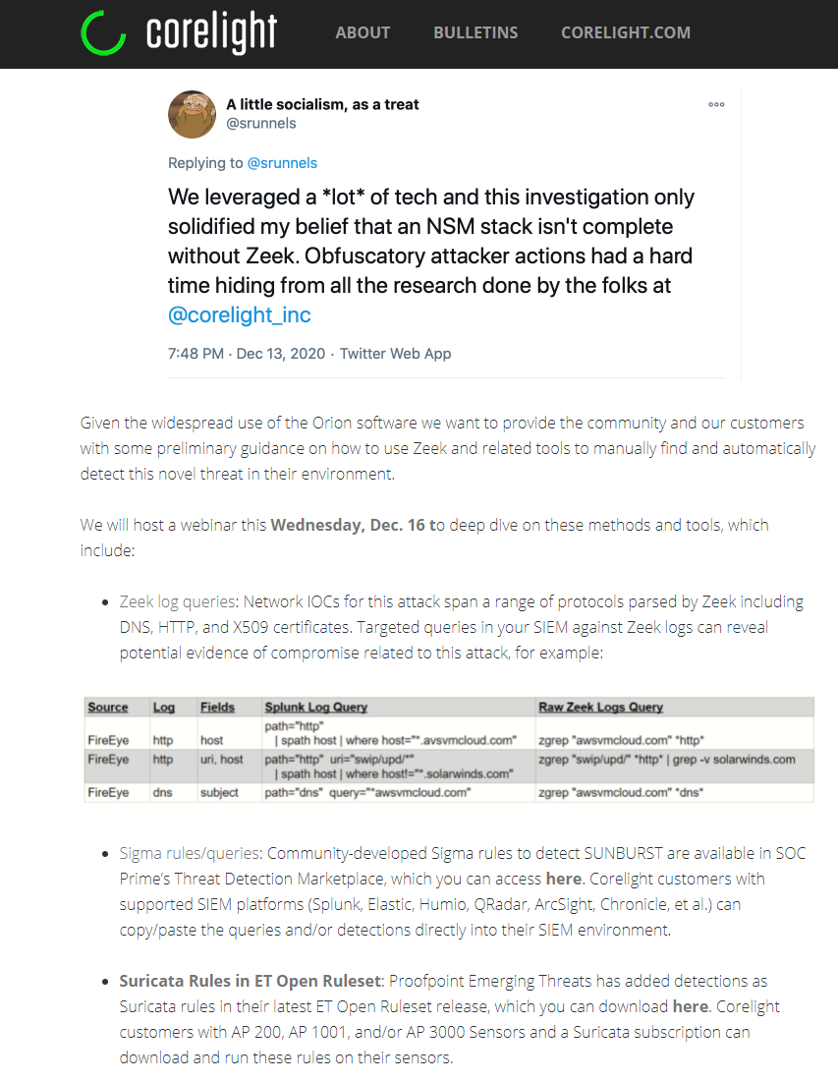
Network Detections
Corelight Zeek
Zeek Log Queries
Community developed Sigma rules
Suricata rules contributed by Proofpoint researchers

Slide 14
Repeatable Analysis

Slide 15
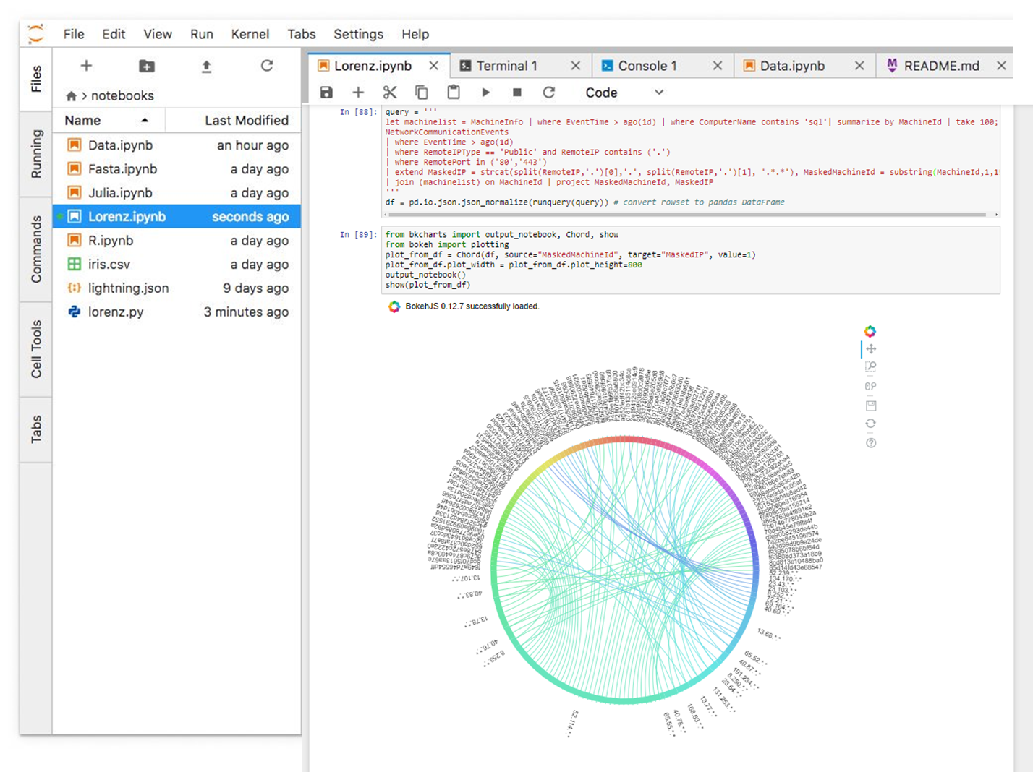
Jupyter

Slide 16
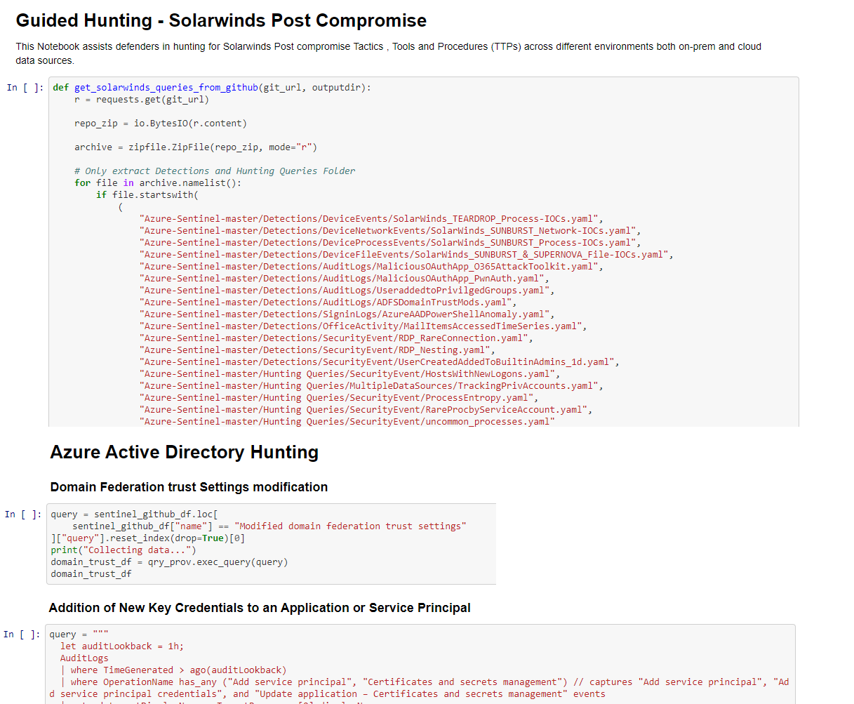
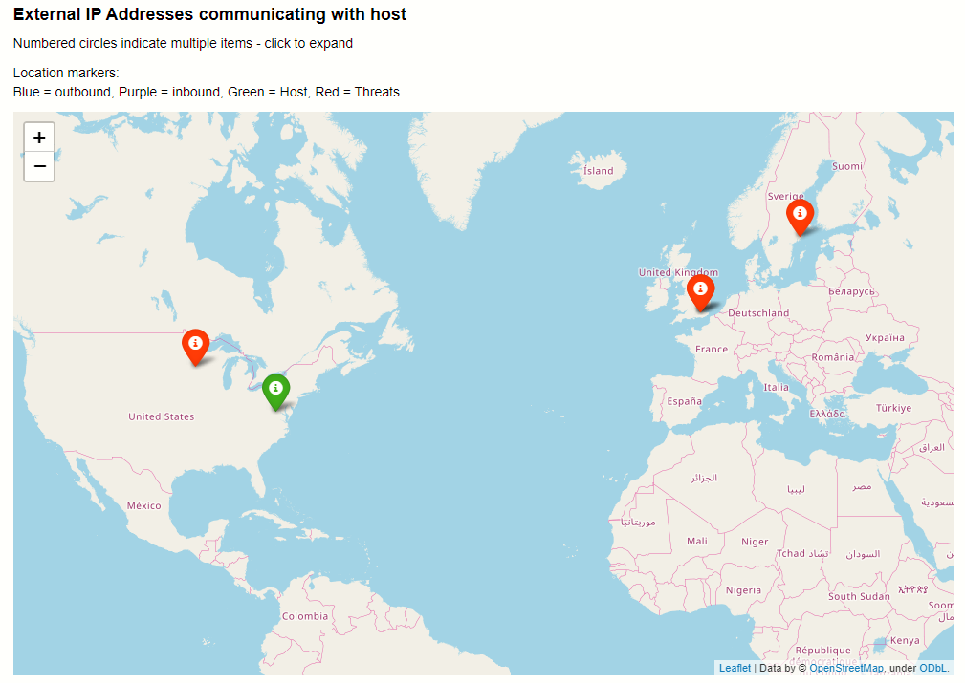
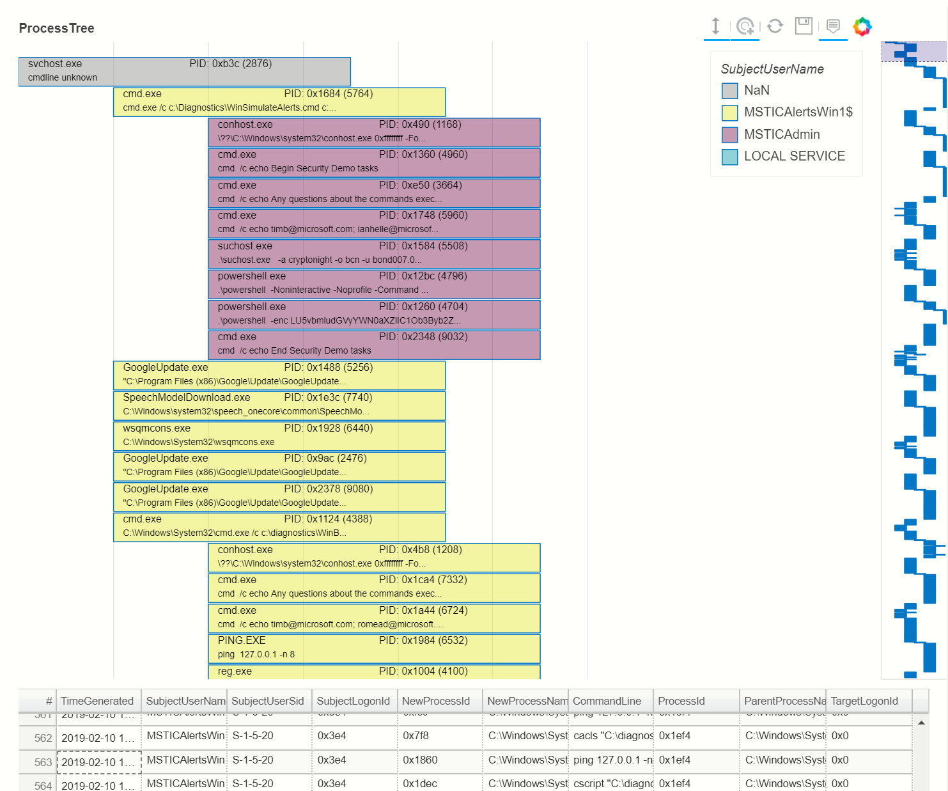
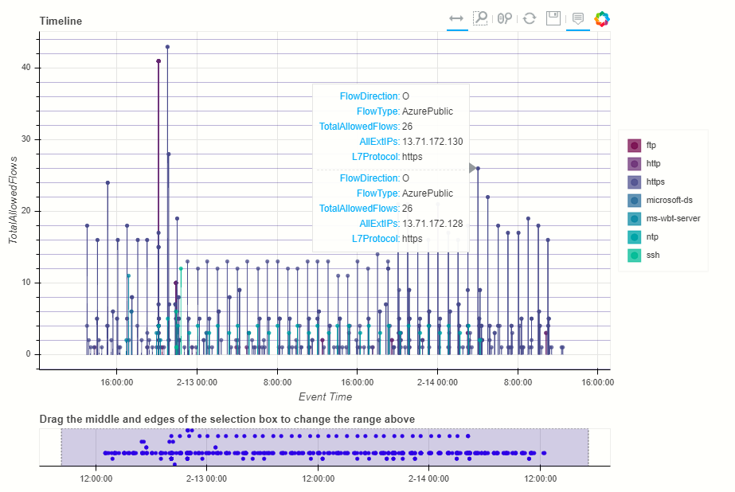
Common SecOps Visualizations
https://msticpy.readthedocs.io/

Slide 17
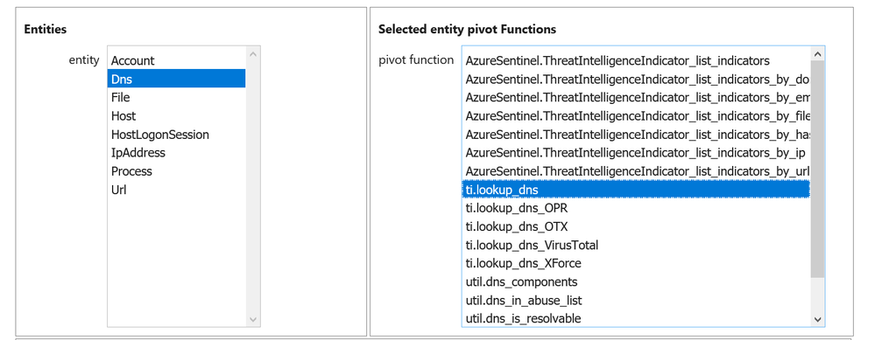
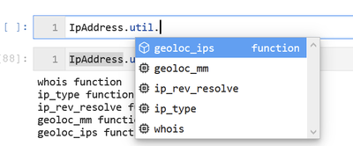
Pivots in MSTICPy
MSTICPy: Open Source Python tools for security investigations
Pivoting is core to analysis
Enrich data by using indicator type as a selector into a data source
Figure 2: Discovering Pivots with tab completion in a Jupyter notebook
Jupyter Notebook Pivot Functions - Microsoft Tech Community

Slide 18
DataSets

Slide 19
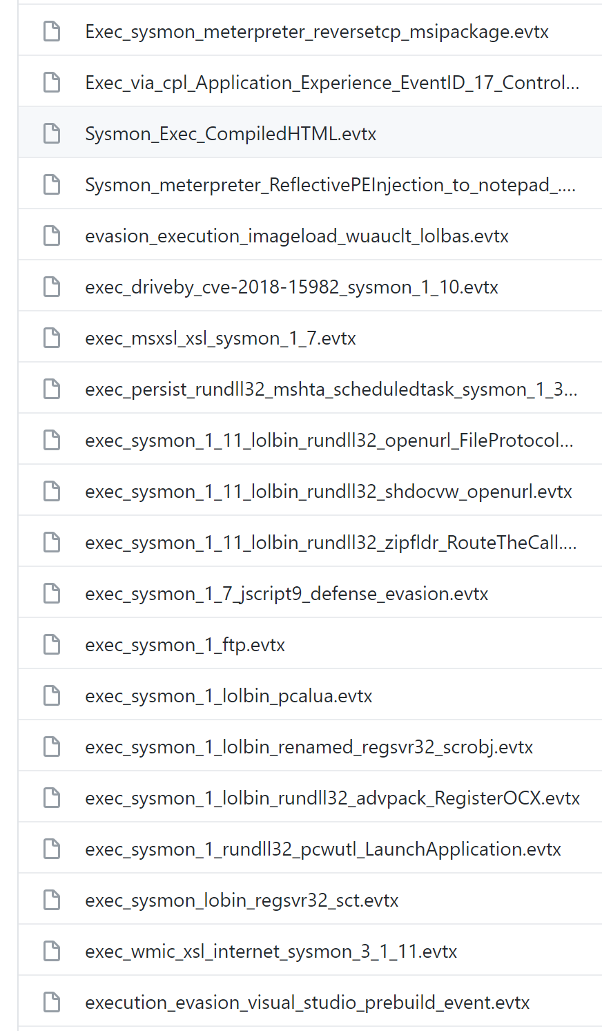
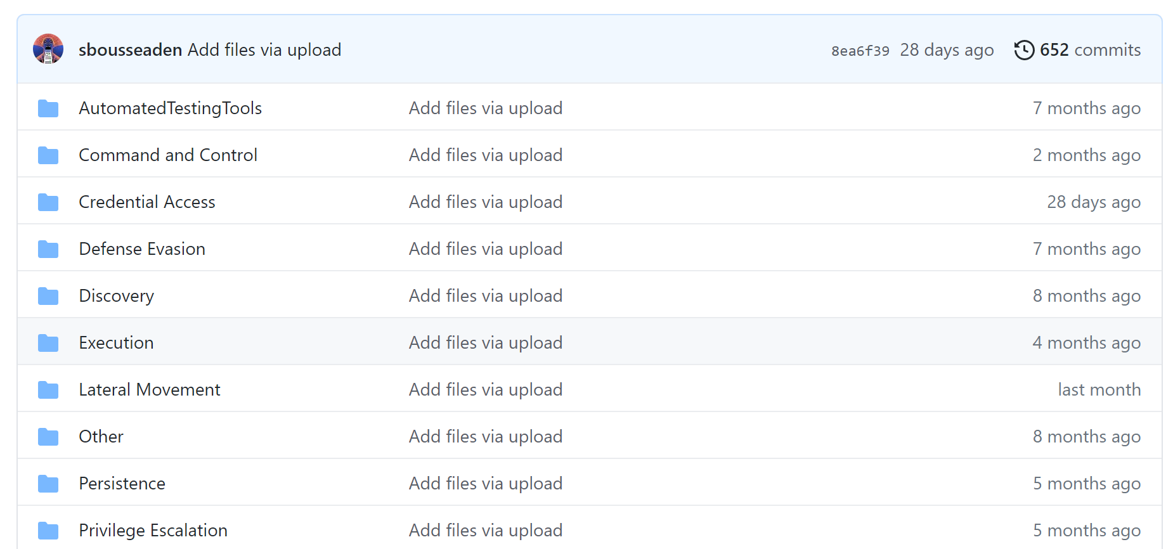
Samir’s EVTX Repository
https://github.com/sbousseaden by @SBousseaden

Slide 20
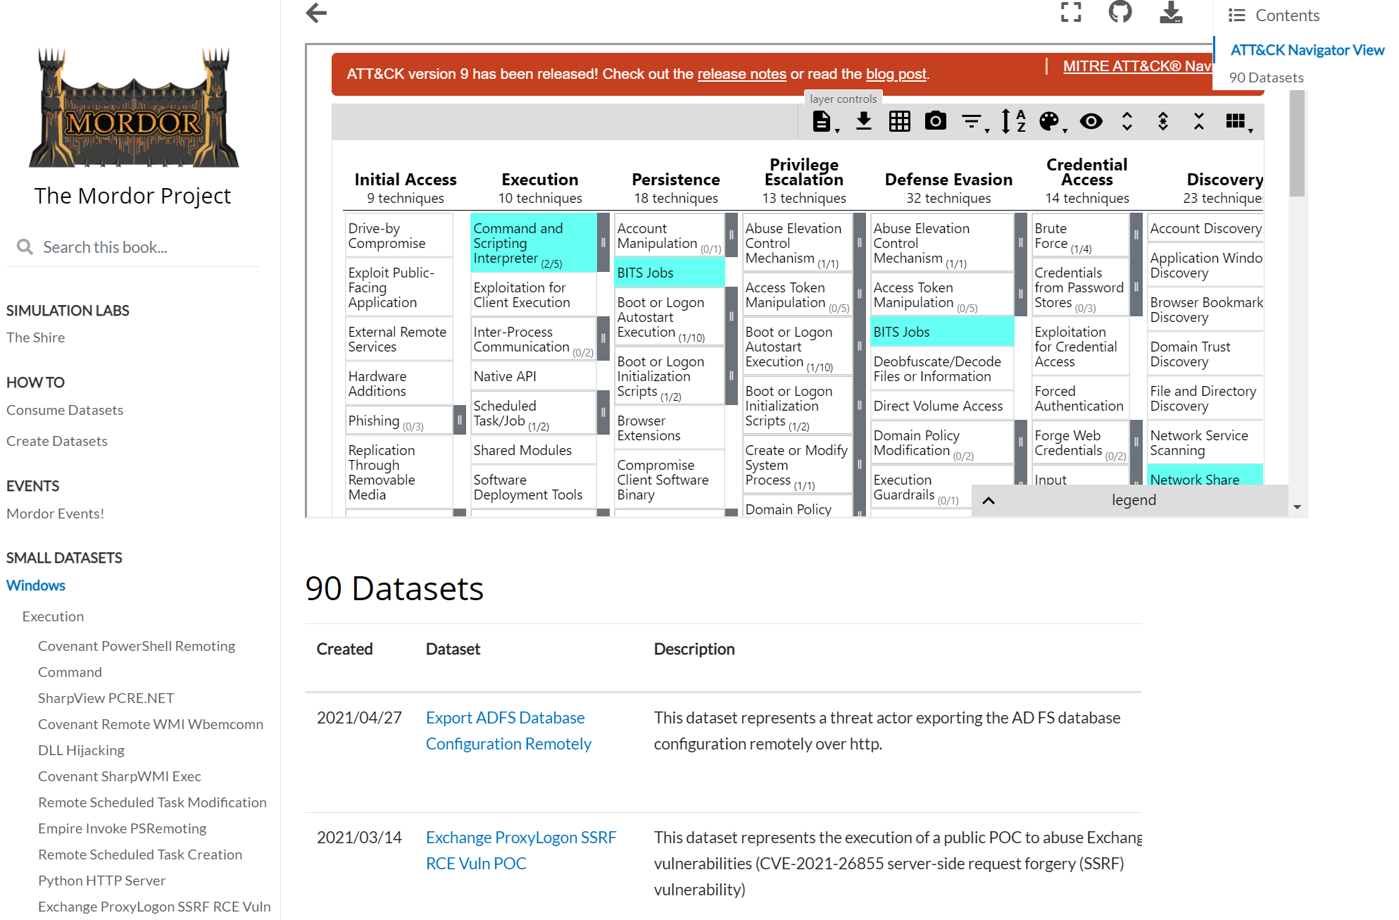
Pre-Recorded Data Sets
Mordor Project
Datasets to expedite the development and validation of analytics.
Data categorized following the Mitre ATT&CK Framework.
Small and large datasets to cover atomic simulations and end-to-end attack scenarios
Windows — The Mordor Project (mordordatasets.com)

Slide 21
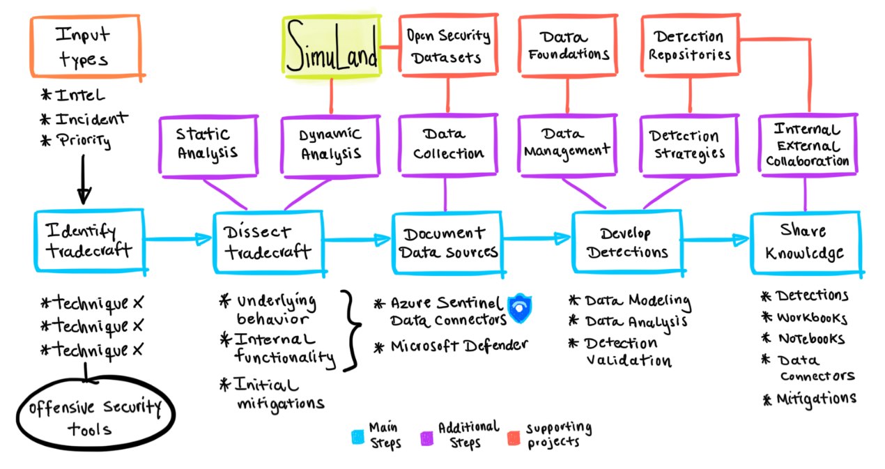
Data Sets and Simulation Environments
SimuLand
An open-source initiative by Microsoft to help security researchers around the world deploy lab environments that reproduce techniques used by real threat actors
Test and verify detections and extend threat research using telemetry and forensic artifacts generated after each simulation exercise.
Integrate it with your own threat research methodology!
Azure/SimuLand: Understand adversary tradecraft and improve detection strategies (github.com)

Slide 22
Promoting Community

Slide 23
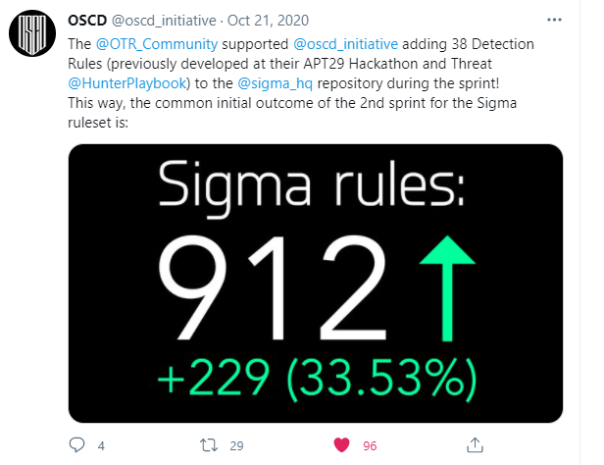
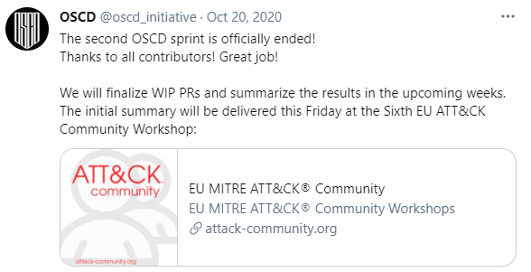
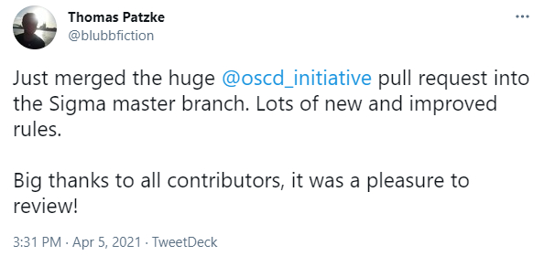
Community
https://twitter.com/oscd_initiative

Slide 24
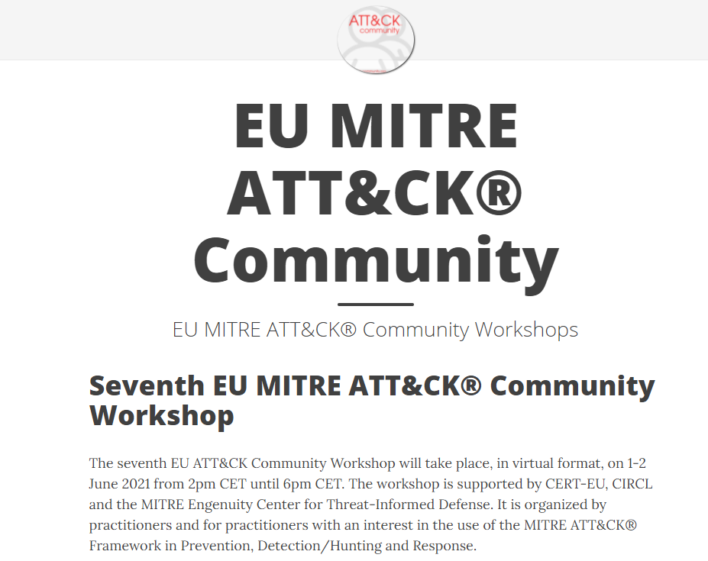
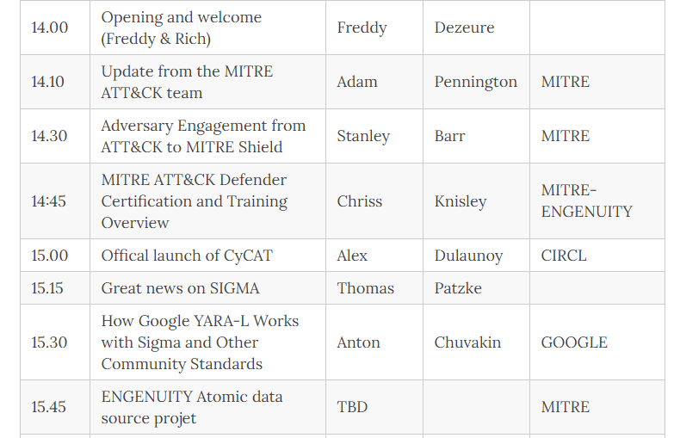
https://www.attack-community.org/event/

Slide 25
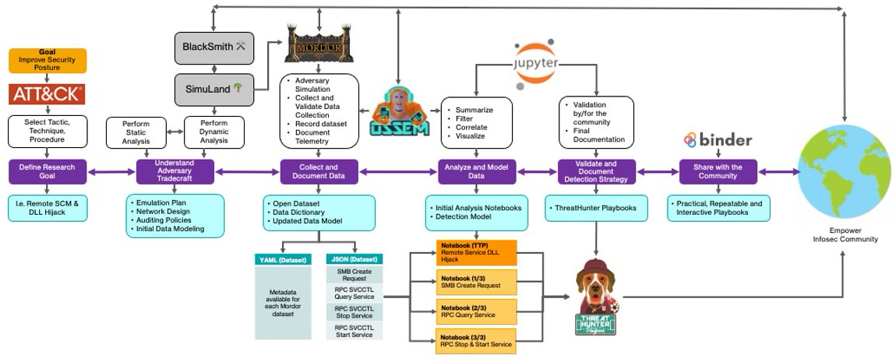
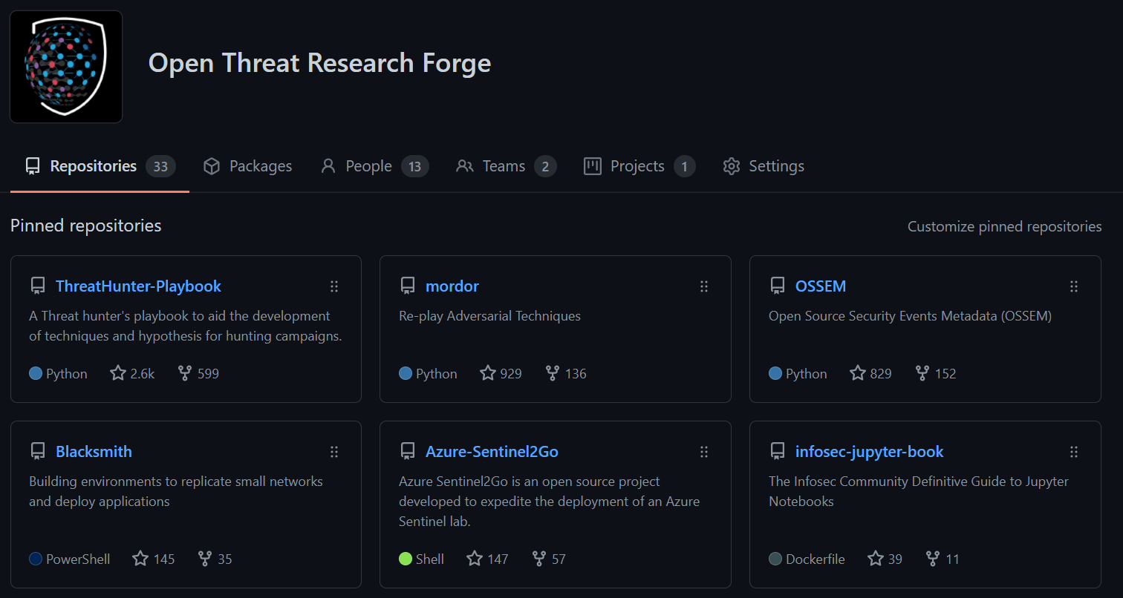
Open Threat Research Community
Open Threat Research (@OTR_Community) / Twitter and Open Threat Research Forge (github.com)

Slide 26
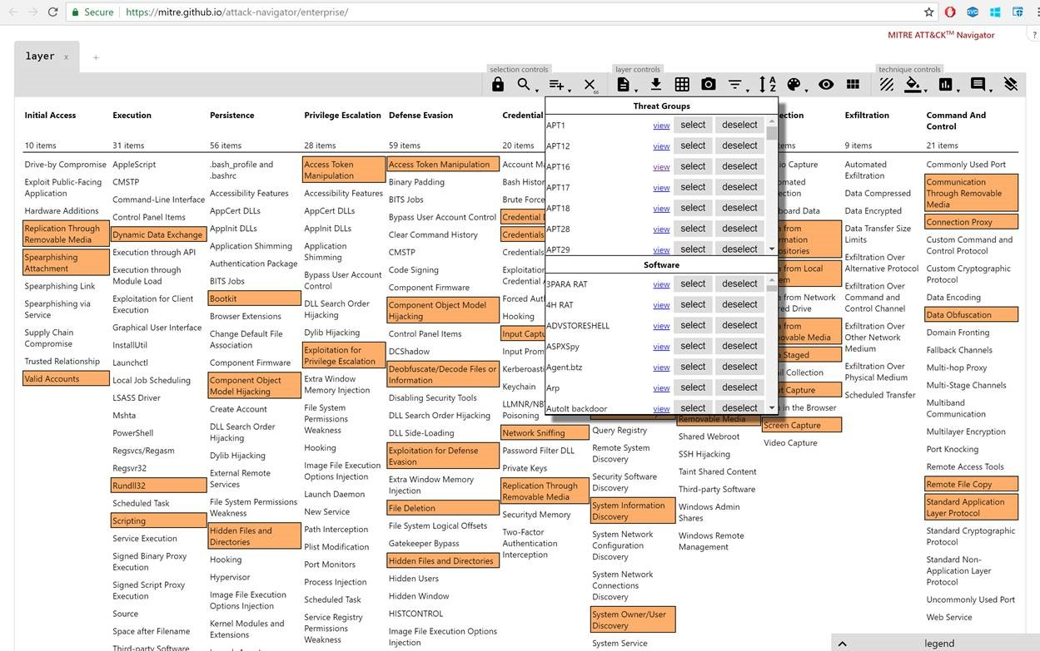
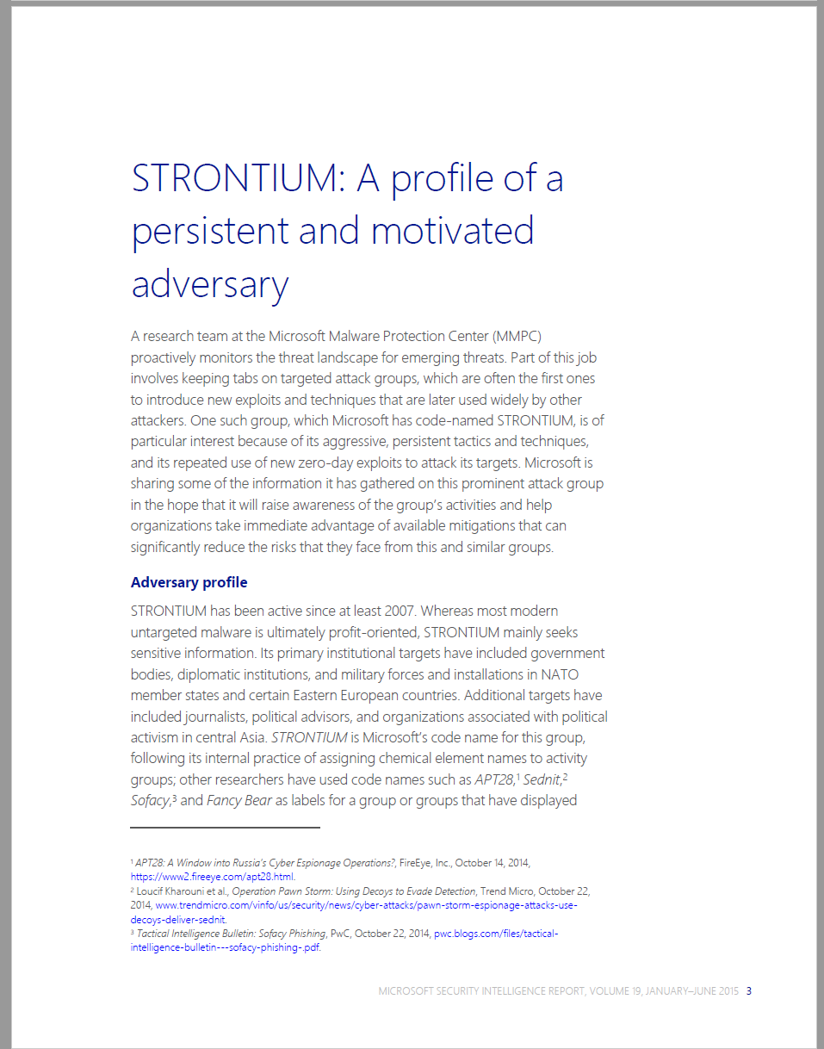


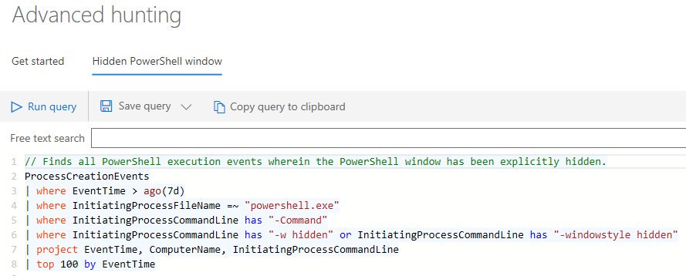
“Githubification” of Infosec
Threat Group
Technique Database
Detection Definitions
Detection Product
Analysis

Slide 27
Call To Action
If you’re a… | Try to:
Defender | Write and apply a Sigma rule Contribute a rule back to an open source repository Try out a Jupyter notebook on mybinder Take an online course on learning Python
Security Product Engineer | Support Sigma rules in your product such as JoeSecurity has done Publish a notebook that uses data from your product Support Python interfaces to your data
Security Researcher | Publish a notebook demonstrating a technique Contribute Sigma rules to a repository Add new attack techniques or examples to MITRE ATT&CK Publish data-sets useful for testing Sigma rules such as the MORDOR project.
InfoSec Manager | Ask a team member to research these technologies and share them with the team Ask peer companies if they have experience with ATT&CK, Sigma, or Jupyter notebooks Send your team members to training on Python or notebooks Use your voice as a customer to encourage vendors to support ATT&CK, Sigma, and Jupyter
Cyber security organization or CERT | Publish advisories with Sigma rules Reference MITRE ATT&CK techniques in advice and guidance

Slide 28
Further Resources
Blog: https://medium.com/@johnlatwc/the-githubification-of-infosec-afbdbfaad1d1
[RU]: https://habr.com/ru/company/microsoft/blog/487584/

